Slide 1
Understanding IP Addressing
Chuck Semeria
Presented by Benyuan Liu
for Internet Routing Seminar
Sep 19, 2000

Slide 2
Outline
What is IP address ?
Classful IP addressing
Subnetting
Classless Inter-Domain Routing (CIDR)
Solutions to Scaling IP Address Space

Slide 3
What is IP address ?
Host 3
Application
HTTP, FTP, SMTP, TELNET, etc
Transport
TCP, UDP
Network
IP
Link
PPP, Ethernet
Physical
www.cs.umass.edu
128.119.240.46
Application
Application
Transport
Transport
Network
Network
Link
Link
Physical
Physical
Host 2
Host 1

Slide 4



Classful IP Addressing
32 bits
Dotted-Decimal Notation

Slide 5
Special Cases:
0.0.0.0: default route, used only during Startup
127.0.0.0: loopback, test TCP/IP for IPC on local machine
host all 0: this host
host all 1: limited broadcast (local net)

Slide 6
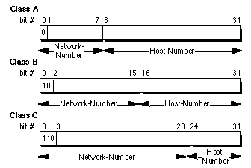
/8
2⁷-2 = 126 networks
2²⁴-2 = 16,777,214 hosts / network
/16
2¹⁴ = 16,384 networks
2¹⁶-2 = 65,534 hosts / network
/24
2²¹ = 2,097,152 networks
2⁸-2 = 254 hosts / network
Class D: (IP Multicasting)
0 4
1110
Class E: (Experimental use)
0 4
1111

Slide 7
Partition of the Classful IP Addresses
2³² = 4,294,967,296 addresses
IP Address Space
Class A
Class B
Class C
D
E
50 %
25%
12.5%
6.25%

Slide 8
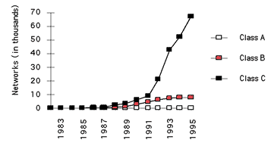
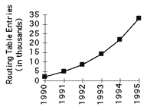
Limitations to Classful Addressing
Running out of address space soon
2³² = 4,294,967,296 addresses
Class boundaries did not foster
efficient allocation of address space
Lack of address class to support medium size company
-- Class B: 65534 hosts/network, too big!
-- Class C: 254 hosts/network, too small!
-- Use multiple class C addresses,
increase routing table!

Slide 9



Subnetting
Idea: Add one more level (subnet number) to the class hierarchy
Subnet Mask

Slide 10
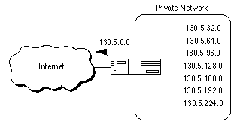
Advantages:
routing table does not grow
flexibility for local network
administrator
hide route flapping from
outside routers

Slide 11
Subnet Design Considerations
Subnet Design Considerations
1) How many total subnets does the organization need today?
2) How many total subnets will the organization need in the
future?
3) How many hosts are there on the organization's largest subnet
today?
4) How many hosts will there be on the organization's largest
subnet in the future?

Slide 12
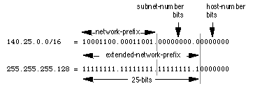
Subnet Design Example
Given : An organization has been assigned the network number
140.25.0.0/16 and it needs to create a set of subnets that
supports up to 60 hosts on each subnet.
1. Defining the Subnet Mask / Extended-Prefix Length
2⁶-2 = 62, no room for expansion; 2⁷-2 = 126

Slide 13
2. Defining Subnet Numbers
Base Net:10001100.00011001.00000000.00000000=140.25.0.0/16
SN#0:10001100.00011001.00000000.00000000=140.25.0.0/25
SN #1:10001100.00011001.00000000.10000000=140.25.0.128/25
……………………………………………………………………..
SN #511:10001100.00011001.11111111.10000000=140.25.255.128/25
3. Defining Hosts Addresses for Each Subnet
SN #3: 10001100.00011001.00000001.1 0000000 = 140.25.1.128/25
Host #1: 10001100.00011001.00000001.1 0000001 = 140.25.1.129/25
Host #2: 10001100.00011001.00000001.1 0000010 = 140.25.1.130/25
………………………………………………………………………….
Host #127: 10001100.00011001.00000001.1 1111110 = 140.25.1.193/25
4. Defining the Broadcast Address for Each Subnet
Subnet #3 broadcast: (all 1's host address)
10001100.00011001.00000001.1 1111111 = 140.25.1.255

Slide 14
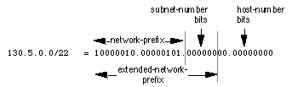

Variable Length Subnet Masks (VLSM)
Classless Inter-Domain Routing (CIDR) very similar
Allow more efficient use of network addresses
2¹⁰-2=1022 hosts/subnet, waste of addresses when host number small
2⁶-2=62 hosts/subnet, good for small subnet

Slide 15
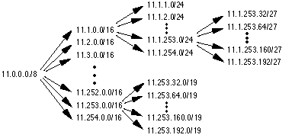
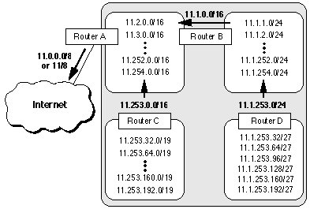
Helps to reduce routing table size (Route Aggregation)
Subnets can be further
recursively divided into
sub-2 nets and so on
A subnet summarizes all
its lower level hierarchies
into a single advertisement

Slide 16
VLSM Design Considerations
At each level, ask the following questions:
1) How many total subnets does this level need today?
2) How many total subnets will this level need in the future?
3) How many hosts are there on this level's largest subnet today?
4) How many hosts will there be on this level's largest subnet be
in the future?
e.g. 5-college

Slide 17

Routing Protocols Must Carry Extended-Network-Prefix Lengths
OSPF, I-IS-IS, IGP, RIP2, RIP1 doesn’t support this
Forwarding Algorithm is Based on the "Longest Match"
Route #1 longest prefix = most specific

Slide 18
VLSM Example
140.25.0.0/16
_0_
_1_
_2_
_13_
_14_
_15_
_0_
_1_
_31_
_31_
_0_
_1_
_14_
_15_
_0_
_1_
_6_
_7_

Slide 19
Define the 16 subnets of 140.25.0.0/16
Base Network:10001100.00011001.00000000.00000000=140.25.0.0/16
SN #0: 10001100.00011001.0000 0000.00000000=140.25.0.0/20
SN #1: 10001100.00011001.0001 0000.00000000 = 140.25.16.0/20
SN #15: 10001100.00011001.1111 0000.00000000 = 140.25.240.0/20
Define the sub-subnets for Subnet #14
SN#14: 10001100.00011001.1110 0000.00000000 = 140.25.224.0/20
SN #14-0: 10001100.00011001.1110 0000 .00000000 = 140.25.224.0/24
SN #14-1: 10001100.00011001.1110 0001 .00000000 = 140.25.225.0/24
SN #14-15: 10001100.00011001.1110 1111 .00000000=140.25.239.0/24
Define the sub 2 -subnets for Subnet #14-14
SN #14-14:10001100.00011001.11101110.00000000=140.25.238.0/24
SN14-14-0:10001100.00011001.11101110.00000000=140.25.238.0/27
SN14-14-1:10001100.00011001.11101110.00100000=140.25.238.32/27
SN14-14-7:10001100.00011001.11101110.11100000=140.25.238.224/27

Slide 20
Classless Inter-Domain Routing (CIDR)
Similar to VLSM, variable network prefix
Eliminates the class concept, more efficient use of addresses
Rapid deployed in 1994/95

Slide 21
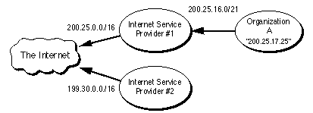
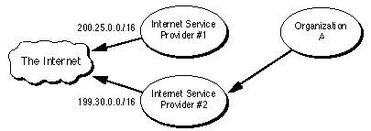
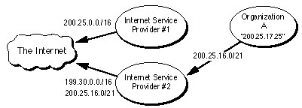
Routing in Classless Environment
Routing Aggregation
- Obtain a new address from IP # 2
(renumbering can be difficult)
- Retain old address, IP#2
advertise exception
(increase size of routing table)

Slide 22
Solution for Scaling Address Space
Appeal to return unused IP Network Prefixes
Private Internets -- a block of addresses for internal use only
Reserved Class A address space
IPv6 (128 bit IP address) 2¹²⁸ = 3.4 * 10³⁸

